Slide 1
Azure Developer Camp

Slide 2
What is
DevOps?

Slide 3
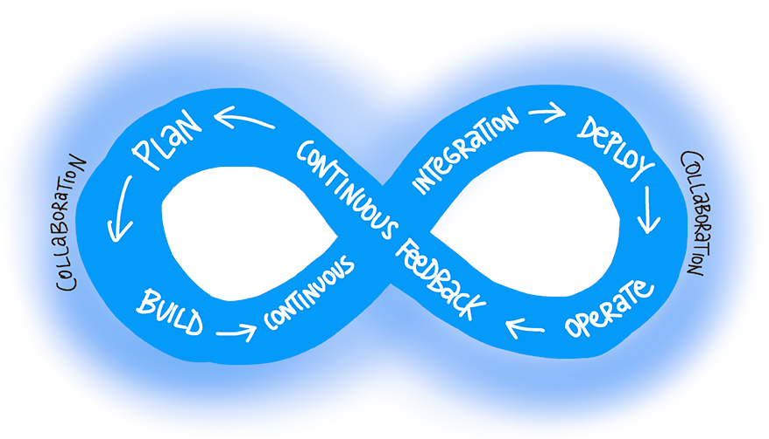
What is DevOps?
Notes:
DevOps is a culture which promotes collaboration between Development and Operations Team to deploy code to production faster in an automated and repeatable way. The word 'DevOps' is a combination of two words 'development' and 'operations.’
DevOps helps to increases an organization's speed to deliver applications and services. It allows organizations to serve their customers better and compete more strongly in the market.
In simple words, DevOps can be defined as an alignment of development and IT operations with better communication and collaboration.

Slide 4
Why DevOps is needed?
Before DevOps, the development and operation team worked in complete isolation
Testing and Deployment were isolated activities done after design-build. Hence, they consumed more time than actual build cycles
Without using DevOps, team members are spending a large amount of their time in testing, deploying, and designing instead of building the project
Manual code deployment leads to human errors in production
Coding and operation teams have their separate timelines and are not in synch causing further delays
Notes:
There is a demand to increase the rate of software delivery by business stakeholders. (As per Forrester Consulting Study, Only 17% of teams can use delivery software fast enough) This proves the pain point.

Slide 5

What DevOps do?
DevOps helps to
Improve application life cycle management processes to make applications effective, more flexible than other methods of developing software. DevOps allows for the constant development of a product evolving it and refining it when it’s already live.
This Process helps to stay ahead to the companies by constantly adapting their products and releasing them onto the market much faster.

Slide 6
How is DevOps different from traditional IT
Old Process
After placing an order for new servers, the Development team works on testing. The Operations team works on extensive paperwork as required in enterprises to deploy the infrastructure.
DevOps
After placing an order for new servers Development and Operations team work together on the paperwork to set-up the new servers. This results in better visibility of infrastructure requirement.

Slide 7
How is DevOps different from traditional IT
Old Process
Projection about failover, redundancy, data center locations, and storage requirements are skewed as no inputs are available from developers who have deep knowledge of the application.
DevOps
Projection about failover, redundancy, disaster recovery, data centre locations, and storage requirements are accurate due to the inputs from the developers.

Slide 8
How is DevOps different from traditional IT
Old Process
Operations team has no clue on the progress of the Development team. Operations team develop a monitoring plan as per their understanding.
DevOps
The Operations team is completely aware of the progress the developers are making. Operations team interact with developers and jointly develop a monitoring plan that caters to the IT and business needs.
Notes:
DevOps: (final) They also use advance Application Performance Monitoring (APM) Tools

Slide 9
How is DevOps different from traditional IT
Old Process
Before go-live, the load testing crashes the application. The release is delayed.
DevOps
Before go-live, the load testing makes the application a bit slow. The development team quickly fixes the bottlenecks. The application is released on time.

Slide 10
Why is DevOps used?
Predictability
Reproducibility
Maintainability
Time to market
Greater Quality
Reduced Risk
Resiliency
Cost Efficiency
Breaks larger code base into small pieces
Notes:
1. Predictability: DevOps offers significantly lower failure rate of new releases
2. Reproducibility: Version everything so that earlier version can be restored anytime.
3. Maintainability: Effortless process of recovery in the event of a new release crashing or disabling the current system.
4. Time to market: DevOps reduces the time to market up to 50% through streamlined software delivery. This is particularly the case for digital and mobile applications.
5. Greater Quality: DevOps helps the team to provide improved quality of application development as it incorporates infrastructure issues.
6. Reduced Risk: DevOps incorporates security aspects in the software delivery lifecycle. It helps in reduction of defects across the lifecycle.
7. Resiliency: The Operational state of the software system is more stable, secure, and changes are auditable.
8. Cost Efficiency: DevOps offers cost efficiency in the software development process which is always an aspiration of IT companies' management.
9. Breaks larger code base into small pieces: DevOps is based on the agile programming method. Therefore, it allows breaking larger code bases into smaller and manageable chunks.

Slide 11


Continue with your own journey
Learn more about DevOps
DevOps Courses on Microsoft Virtual Academy
facebook.com/MSFTDev.US
@MSDEV

Slide 12
DevOps
Lifecycle
Notes:
DevOps is deep integration between development and operations. Understanding DevOps is not possible without knowing DevOps lifecycle.
Let's talk about the DevOps lifecycle

Slide 13
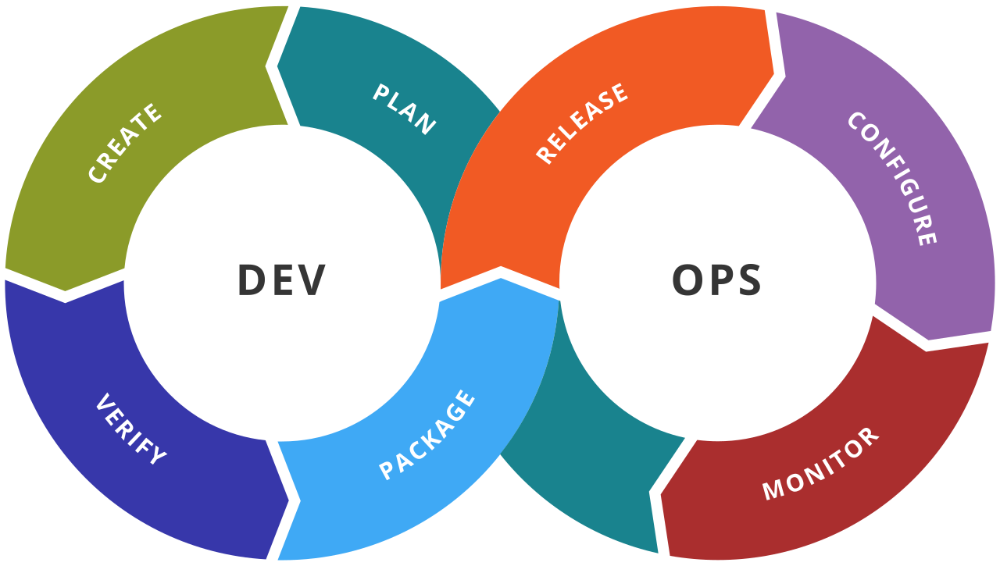
DevOps Lifecycle
Notes:
1. Development (plan and create)
In this DevOps stage the development of software takes place constantly. In this phase, the entire development process is separated into small development cycles. This benefits DevOps team to speed up software development and delivery process.
2. Testing (verify)
QA team use tools like Selenium to identify and fix bugs in the new piece of code.
3. Integration (package)
In this stage, new functionality is integrated with the prevailing code, and testing takes place. Continuous development is only possible due to continuous integration and testing.
4. Deployment (release and configure)
In this phase, the deployment process takes place continuously. It is performed in such a manner that any changes made any time in the code, should not affect the functioning of high traffic website.
5. Monitoring (monitor)
In this phase, operation team will take care of the inappropriate system behavior or bugs which are found in production.

Slide 14
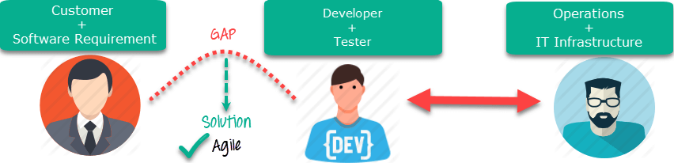
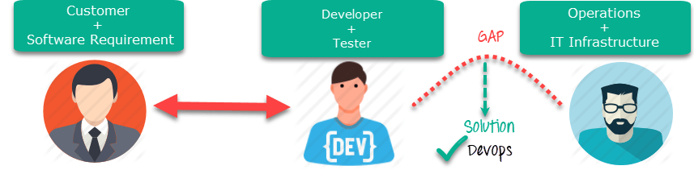
How is DevOps different from Agile?
Notes:
Agile (first image): Agile addresses gaps in Customer and Developer communications
DevOps (second image): DevOps addresses gaps in Developer and IT Operations communications

Slide 15
Builds in DevOps
Manual Build
Unseen manual steps often required
Little or no build quality
“Works on my machine”
Slow feedback cycles
Merge debt accumulates
Builds and deploy moved to weekends
Reluctance to try new technologies
Anyone can queue a build
Consistency
Includes test and build quality
Fast feedback on build quality
Merging code when fresh
Increasing use of automated tests
Faster check-in cadence
Continuous Integration
VS

Slide 16
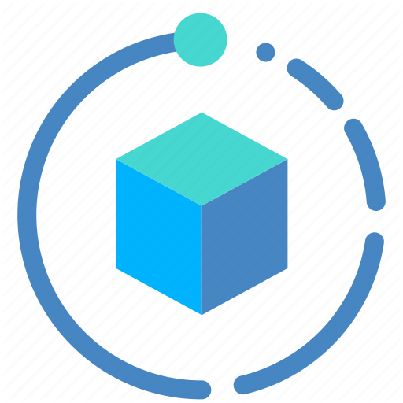
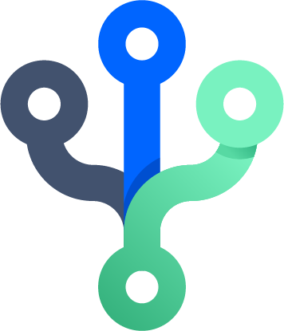
Build Automation and Continuous Integration
Automated builds are valuable because they:
Validate that code compilation doesn’t just succeed “on my machine”.
Run as many task as needed, such as scripting, testing, packing, or anything else required.
Publish to a drop folder or network share to be picked up for deployment
Maintain an audit history for builds details, drop details, and associated work items.
In DevOps, Automated Builds Are an Integral Part of Continuous Integration (CI)

Slide 17
Continuous Integration
Continuous Integration CI provides many benefits:
Improving code quality based on rapid feedback.
Triggering for automated testing for every code change.
Better managing technical debt and conducting code analysis.
Reducing long, difficult and bug-inducing merges
Increasing confidence in code long before production.
Is the practice of merging all developer working copies to a shared code line several times a day and validating each integration with an automated build.
CI is often defined as having a build with unit tests that executes at every commit or check-in to version control.

Slide 18
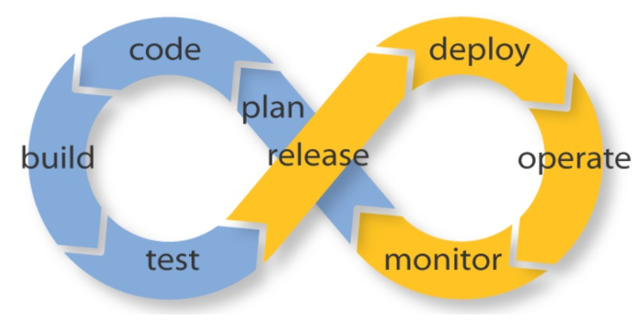
Continuous Integration and Delivery

Slide 19
“Continuous improvement”
Keep inventory at a minimum
Minimize the queue of orders
Maximize efficiency in the manufacturing process
Notes:
(introduction)
“Continuous improvement” is the mantra for lean manufacturing and practitioners continually evaluate ways to
Keep inventory at a minimum. Lean manufacturing means minimal inventory on hand: raw materials (materials used to produce goods) and finished inventory (completed products waiting to be assigned to an order and/or shipped).
Minimize the queue of orders. Ideally, orders received should move immediately into fulfilment mode. A key metric of lean manufacturing will always be “order to ship” time.
Maximize efficiency in the manufacturing process. Process re-engineering and improved automation will marry into a goal to produce goods as quickly as possible. Each station of operation along the way (cut, weld, assemble, test, etc.) is evaluated for inefficiencies.

Slide 20
Continuous Integration (prerequisites)
Using a version repository for source code
Regular code check in schedule
Automate testing for the code changes
Automate the build
Deploy build in preproduction
Notes:
(introduction)
To achieve continuous integration, there are few prerequisites to be implemented, as follows:
Continuous integration is a DevOps best practice wherein developers continuously integrate their code in small logical units to a common shared repository with regularity (for example, once a day). The advantage of such a process is the transparency of the code's quality and fitness for its intended purpose. Otherwise, bulk code integration after the lapse of a fixed time period could expose many defects or integration challenges which could be expensive to resolve.

Slide 21
Continuous Integration (tools)
Jenkins
TeamCity
Travis
Go CD
Buddy
Bitbucket
Chef
Microsoft Teamcenter
CruiseControl
Bamboo
GitLab CI
CircleCI
Codeship
Notes:
.

Slide 22
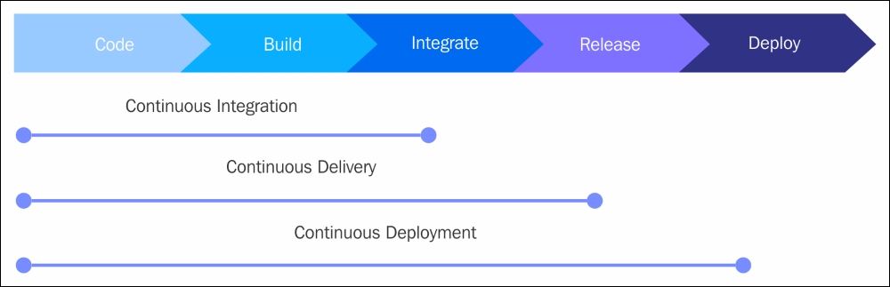
Roles
Notes:
The following figure represents the roles of continuous integration, delivery, and deployment:

Slide 23
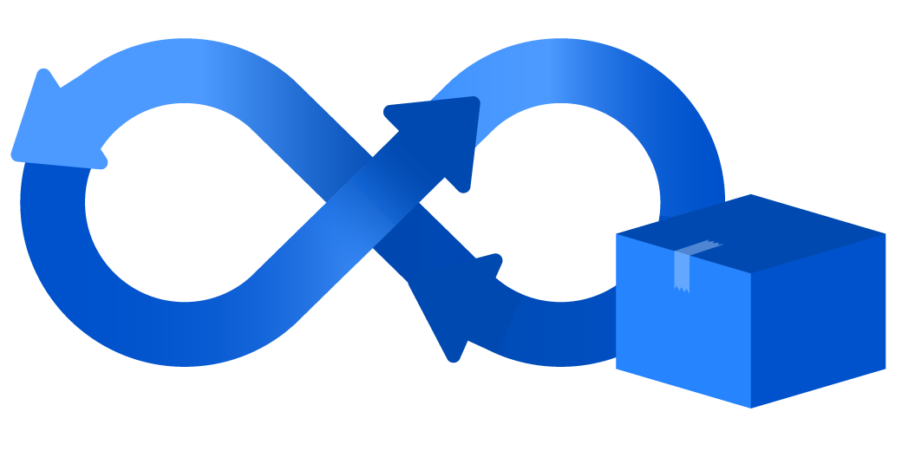
Continuous Delivery
Continuous delivery is the next step of continuous integration in the software development cycle; it enables rapid and reliable development of software and delivery of product with the least amount of manual effort or overhead. In continuous integration, as we have seen, code is developed incorporating reviews, followed by automated building and testing.
Notes:
In continuous delivery, the product is moved to the preproduction (staging) environment in small frequent units to thoroughly test for user acceptance. The focus is on understanding the performance of the features and functionality related issues of the software.

Slide 24
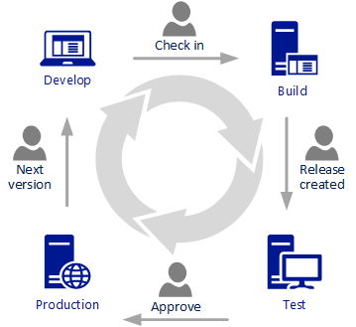
Continuous Delivery
Encourages Infrastructure as Code and configuration as code.
Enables automated testing throughout the pipeline.
Provides visibility and fast feedback cycles.
Makes going to production a low-stress activity.
Developed code is continuously delivered
Code is constantly and regularly reviewed
High-quality software is deployed rapidly, reliably, and repeatedly
Maximum automation and minimal manual overhead
Notes:
In continuous delivery, the product is moved to the preproduction (staging) environment in small frequent units to thoroughly test for user acceptance. The focus is on understanding the performance of the features and functionality related issues of the software.

Slide 25
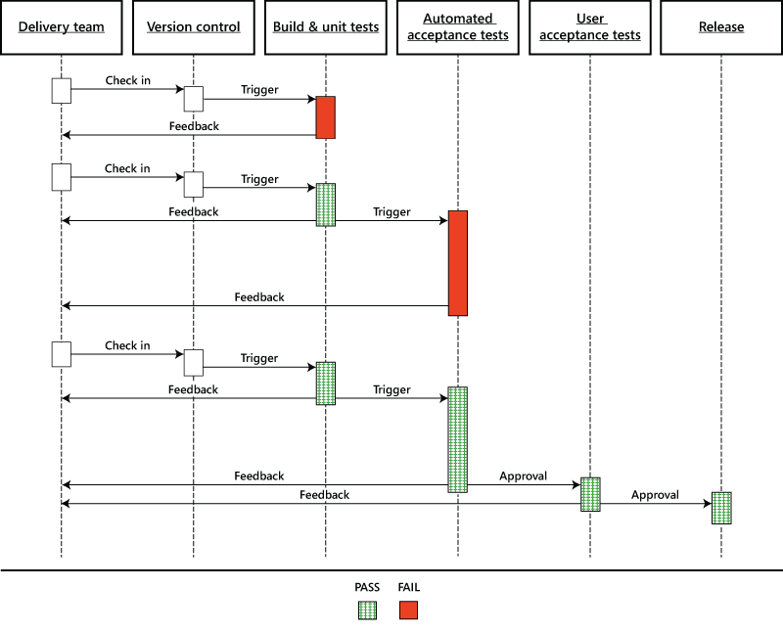
Conceptualizing a Release Pipeline
Notes:
One useful way to identify your current process, including tasks needed for each environment, approvals required, and machines, is by engaging in a white-board session with your entire team. Make sure that developers, testers, operations, and managers are in the meeting so that all steps are captured.

Slide 26
Continuous Deployment
Continuous deployment is the fully matured and complete process cycle of code change, passing through every phase of the software life cycle to be deployed to production environments.
Notes:
Continuous deployment requires the entire process to be automated--also termed as automated application release--through all stages, such as the packaging of the application, ensuring the dependencies are integrated, deployment testing, and the production of adequate documentation for compliance.

Slide 27
Continuous Deployment (benefits)
Frequent product releases deliver software as fast as possible
Automated and accelerated product releases with the code change
Code changes qualify for production both from a technical and quality view point
The most current version of the product is ready in shippable format

Slide 28
Continuous Deployment (benefits)
Deployment modelling reduces errors, resulting in better product quality
Consolidated access to all tools, process and resource data leads to quicker troubleshooting and time to market
Effective collaboration between dev, QA, and operation teams leads to higher output and better customer satisfaction
Facilitates lower audit efforts owing to a centralized view of all phase activities

Slide 29
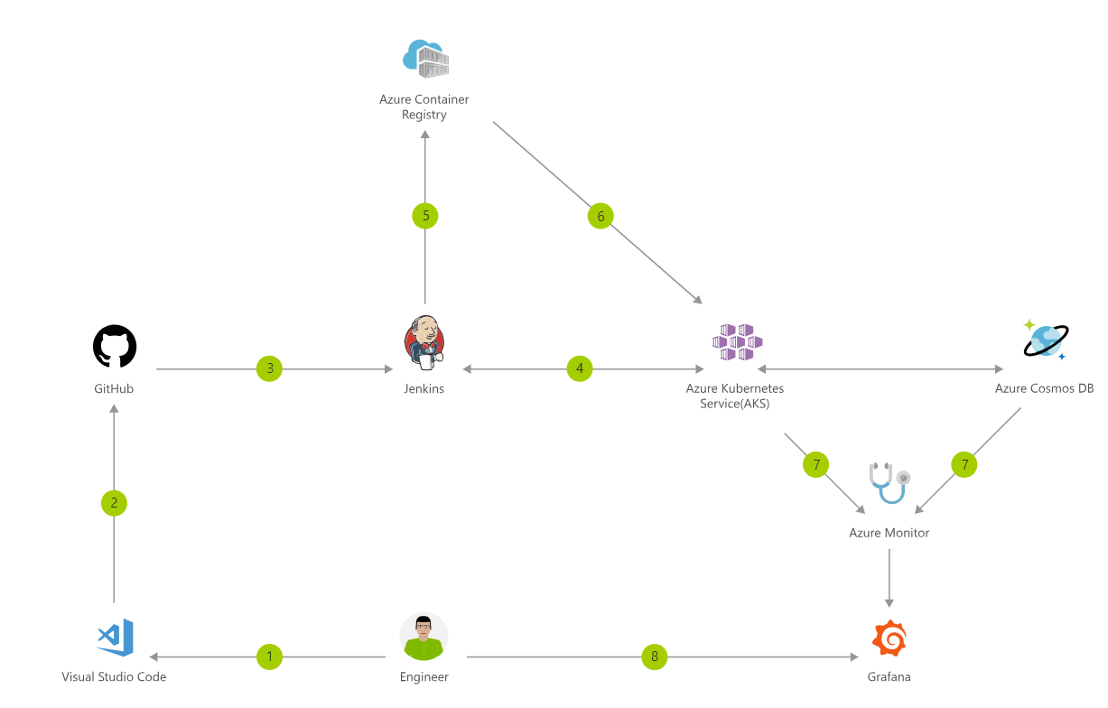
Container CI/CD Using Jenkins and AKS
Notes:
Containers make it easy for you to continuously build and deploy applications. By orchestrating the deployment of those containers using Azure Kubernetes Service (AKS), you can achieve replicable, manageable clusters of containers.
In this example is shown how to do CI/CD (Continuous Integration and Continuous Deployment)
Change application source code.
Commit code to GitHub.
Continuous Integration Trigger to Jenkins.
Jenkins triggers a build job using Azure Kubernetes Service (AKS) for a dynamic build agent.
Jenkins builds and pushes Docker container to Azure Container Registry.
Jenkins deploys your new containerized app to Kubernetes on Azure.
Container Service (AKS), backed by Azure Cosmos DB.
Grafana displays visualization of infrastructure and application metrics via Azure Monitor.
Monitor application and make improvements.
Grafana (Grafana is an open source metric analytics & visualization suite. )

Slide 30
Infrastructure as Code (IaC)
Notes:
Infrastructure as Code (IaC) is a means to perform infrastructure services through the defining of configuration files. In DevOps' scope, IaC is the automation of routine tasks through code, typically as configuration definition files, such as shell scripts, Ansible playbooks, Chef recipes, or Puppet manifests. It's usually a server and client setup with push or pull-based mechanisms, or agentless through secured shell (SSH).

Slide 31
Advantages of IaC
The use of definition files and code to update system configuration is quick
The version of all the code and changes is less error prone and has reproducible results
Thorough testing of the deployment with IaC and test systems
Smaller regular changes are easy to manage, bigger infrastructure updates are likely to contain errors that are difficult to detect
Audit tracking and compliance are easy with definition files
Notes:
(intro)
Many regular tasks on systems such as create, start, stop, delete, terminate, and restarting virtual or bare-metal machines are performed through software. In traditional on-premise systems, many of the system administrative tasks were manual and person dependent. However, with the explosion of big data with cloud computing, all the regular system activities and tasks are managed like any software code. They are maintained in code repositories, and the latest build updates are tested for deployment.

Slide 32
Advantages of IaC
Multiple servers update simultaneously
System availability is high, with less down time
Some tools for IaC are as follows:
Ansible tower
CFEngine
Chef
Puppet
SaltStack

Slide 33
Microservices

Slide 34
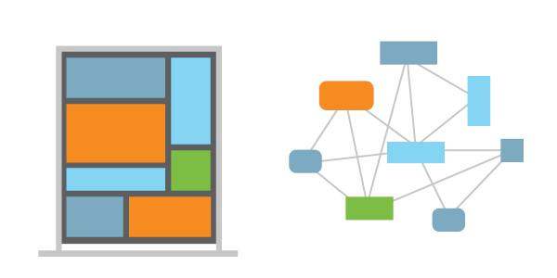
What are Microservices?
Microservices describes the architectural pattern of composing a distributed application from separately deployable services that perform specific business functions and communicate over web interfaces.
DevOps teams encapsulate individual pieces of functionality in microservices and build larger systems by composing the microservices like building blocks
Notes:
Microservices apply an example of the open/closed principle: they are open for extension (using the interfaces they expose) and closed for modification (in that each is implemented and versioned independently).
Microservices provide many benefits over monolithic architectures. They can remove single points of failure (SPOFs) by ensuring issues in one service do not crash or impact other parts of an application. Individual microservices can be scaled out independently to provide additional availability and capacity. DevOps teams can extend functionality by adding new microservices without unnecessarily affecting other parts of the application.

Slide 35
What are Microservices?
Highly maintainable and testable
Loosely coupled
Independently deployable
Organized around business capabilities.
Notes:
(intro)
Microservices - also known as the microservice architecture - is an architectural style that structures an application as a collection of services that are… (list in the slide)
Using microservices can increase team velocity. DevOps practices, such as Continuous Integration and Continuous Delivery, are used to drive microservice deployments.

Slide 36
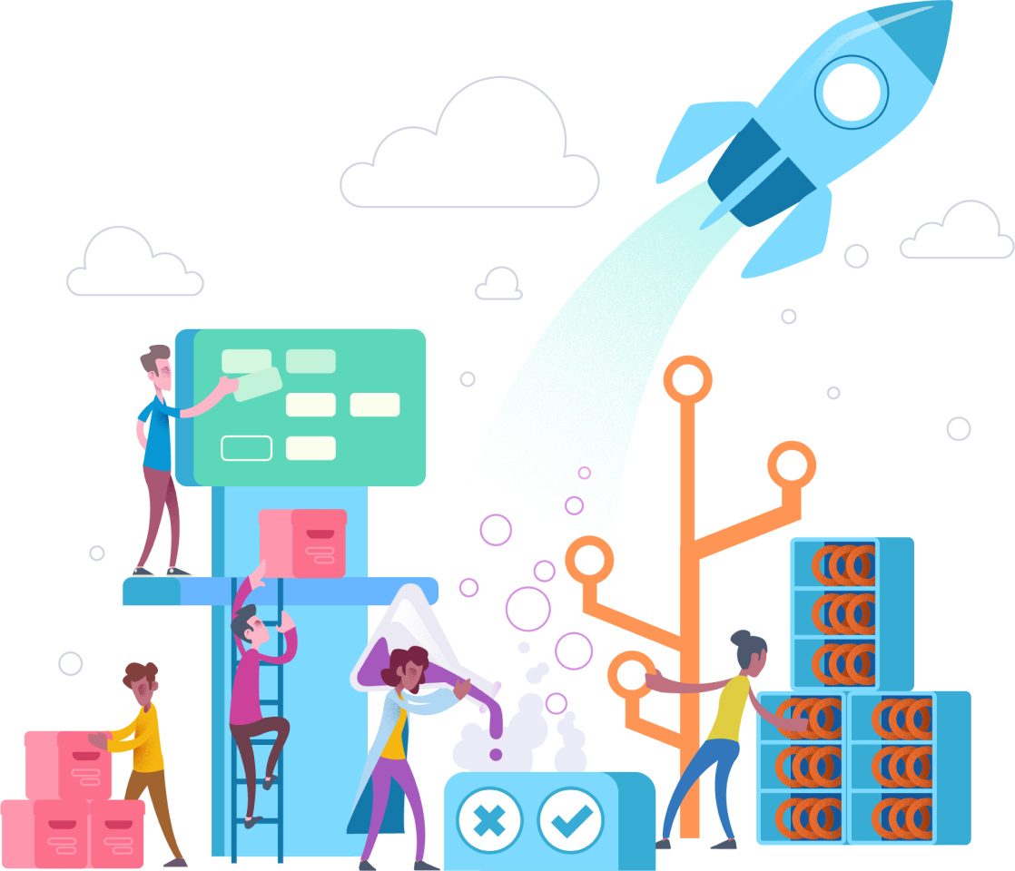
Azure DevOps Service

Slide 37
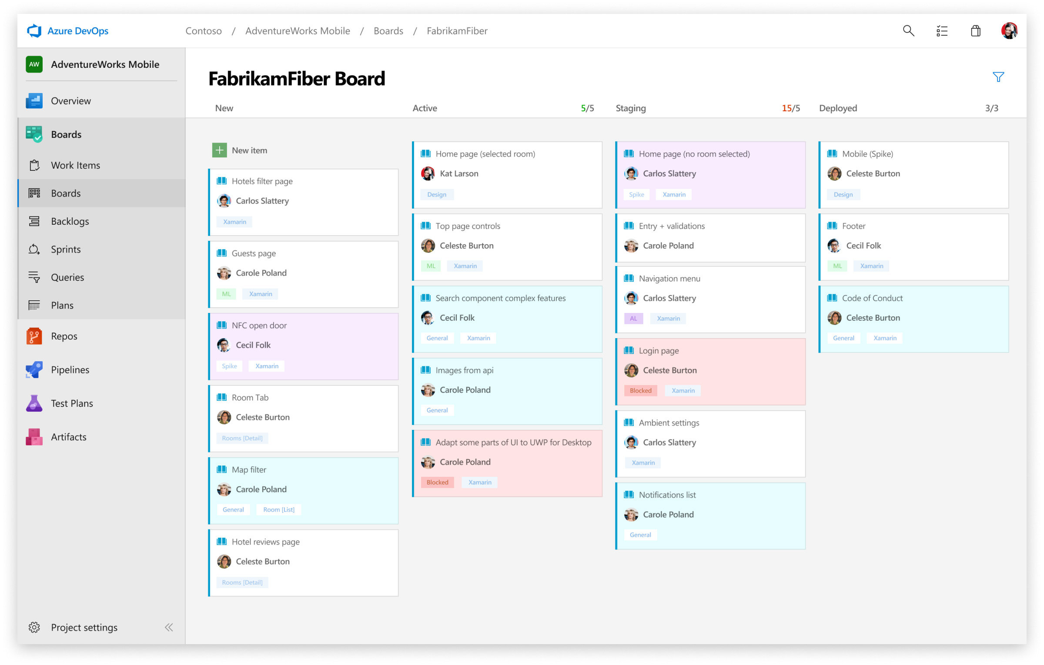
Azure DevOps services – Azure Boards
Notes:
Deliver value to your users faster using proven agile tools to plan, track and discuss work across your teams.
Azure boards Combine drag-and-drop sprint planning and flexible work item tracking with comprehensive traceability to have the perfect home for all your ideas – big and small.
Also use Built-in scrum boards and planning tools to help your teams run sprints, stand-ups and planning meetings

Slide 38
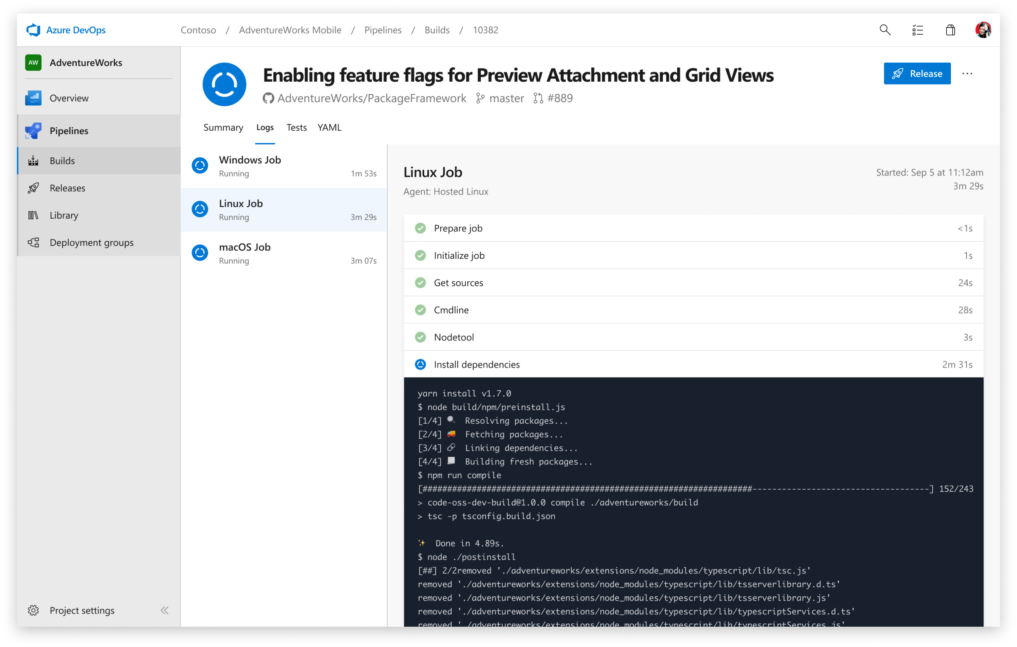
Azure DevOps services – Azure Pipelines
Notes:
Build, test and deploy with CI/CD that works with any language, platform and cloud. Connect to GitHub or any other Git provider and deploy continuously.
Automate your builds and deployments with Pipelines so you spend less time with the nuts and bolts, and more time being creative.
Azure Pipelines makes easily build and push images to container registries such as Docker Hub and Azure Container Registry. Deploy containers to individual hosts or Kubernetes.

Slide 39
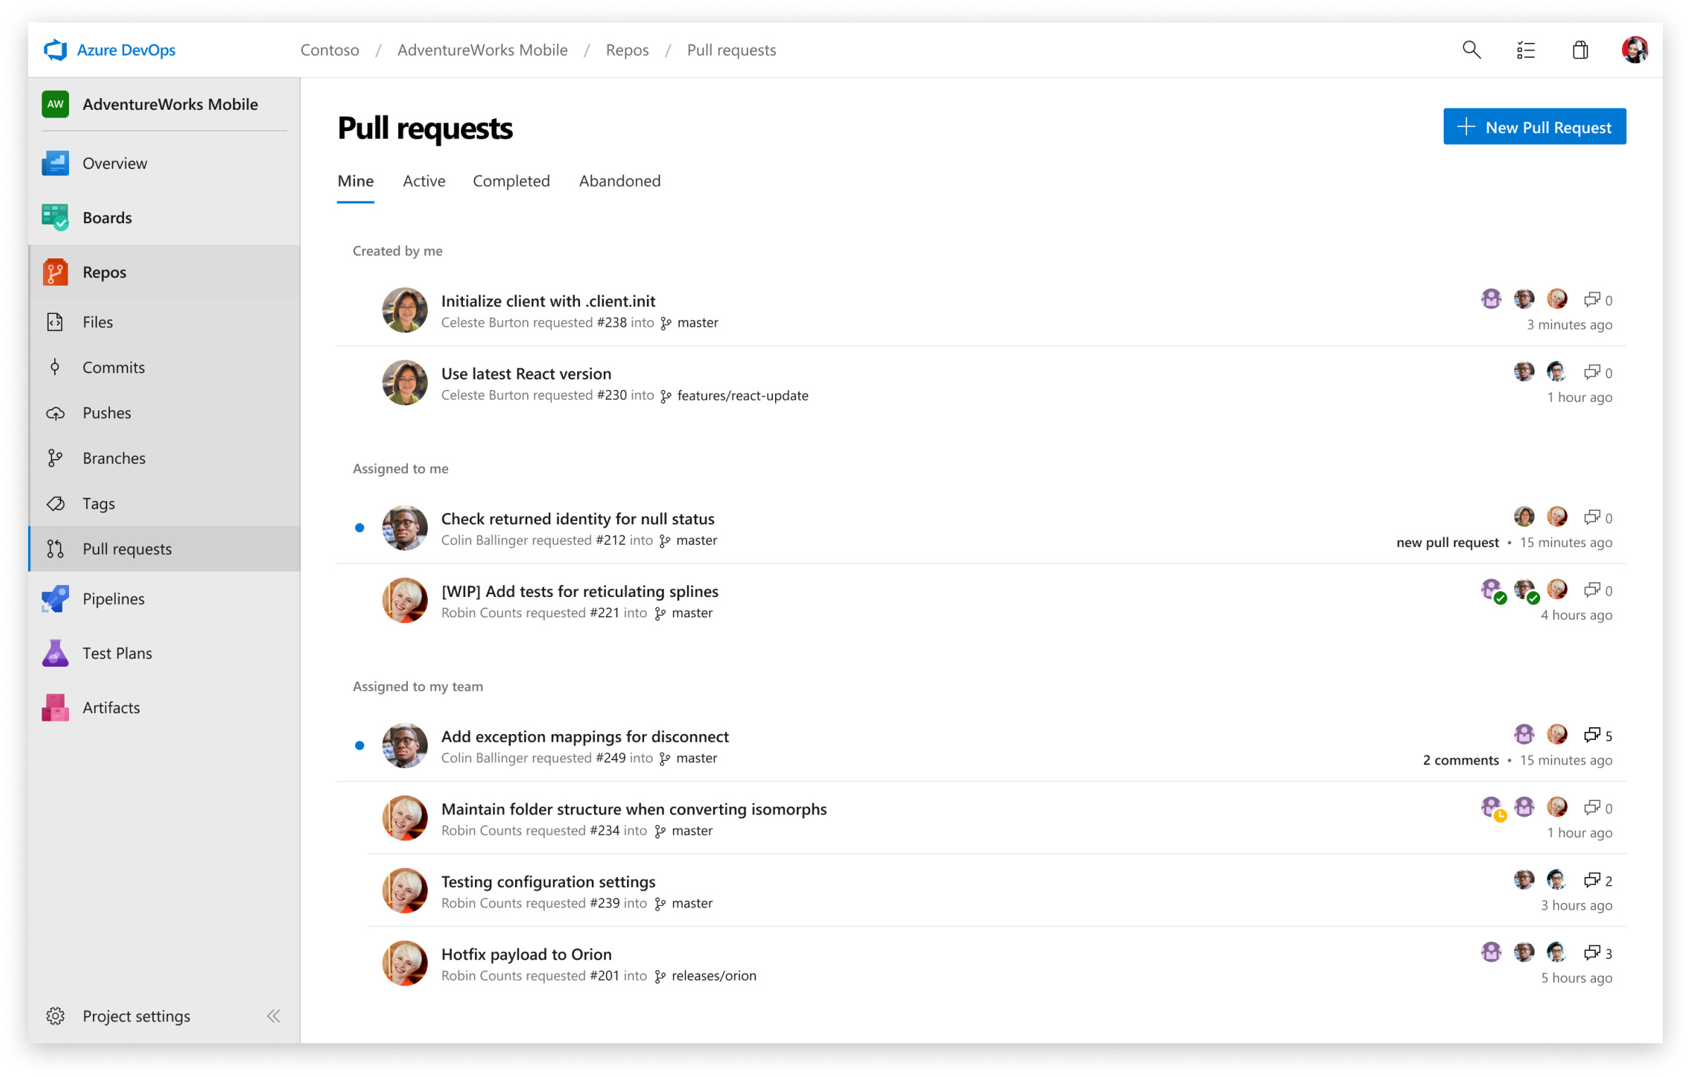
Azure DevOps services – Azure Repos
Notes:
With Azure Repos you’ll get unlimited, cloud-hosted private Git repos and collaborate to build better code with pull requests and advanced file management.
Azure Repos has:
Support for any Git client:
Securely connect with and push code into your Git repos from any IDE, editor or Git client. Web hooks and API integration:
Add validations and extensions from the marketplace or build your own using web hooks and REST APIs. Semantic code search:
Quickly find what you’re looking for with code-aware search that understands classes and variables.

Slide 40
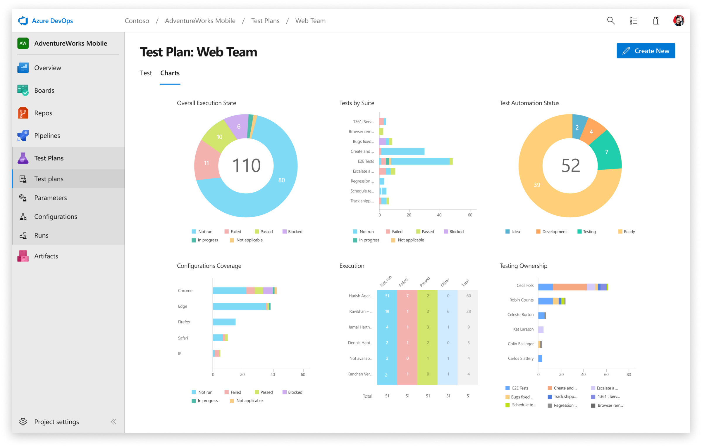
Azure DevOps services – Azure Test Plans
Notes:
Azure Test Plans helps to Improve your code quality using planned and exploratory testing services for your apps.
With Azure Test Plans you can
Capture rich data Test across web and desktop Get end-to-end traceability

Slide 41
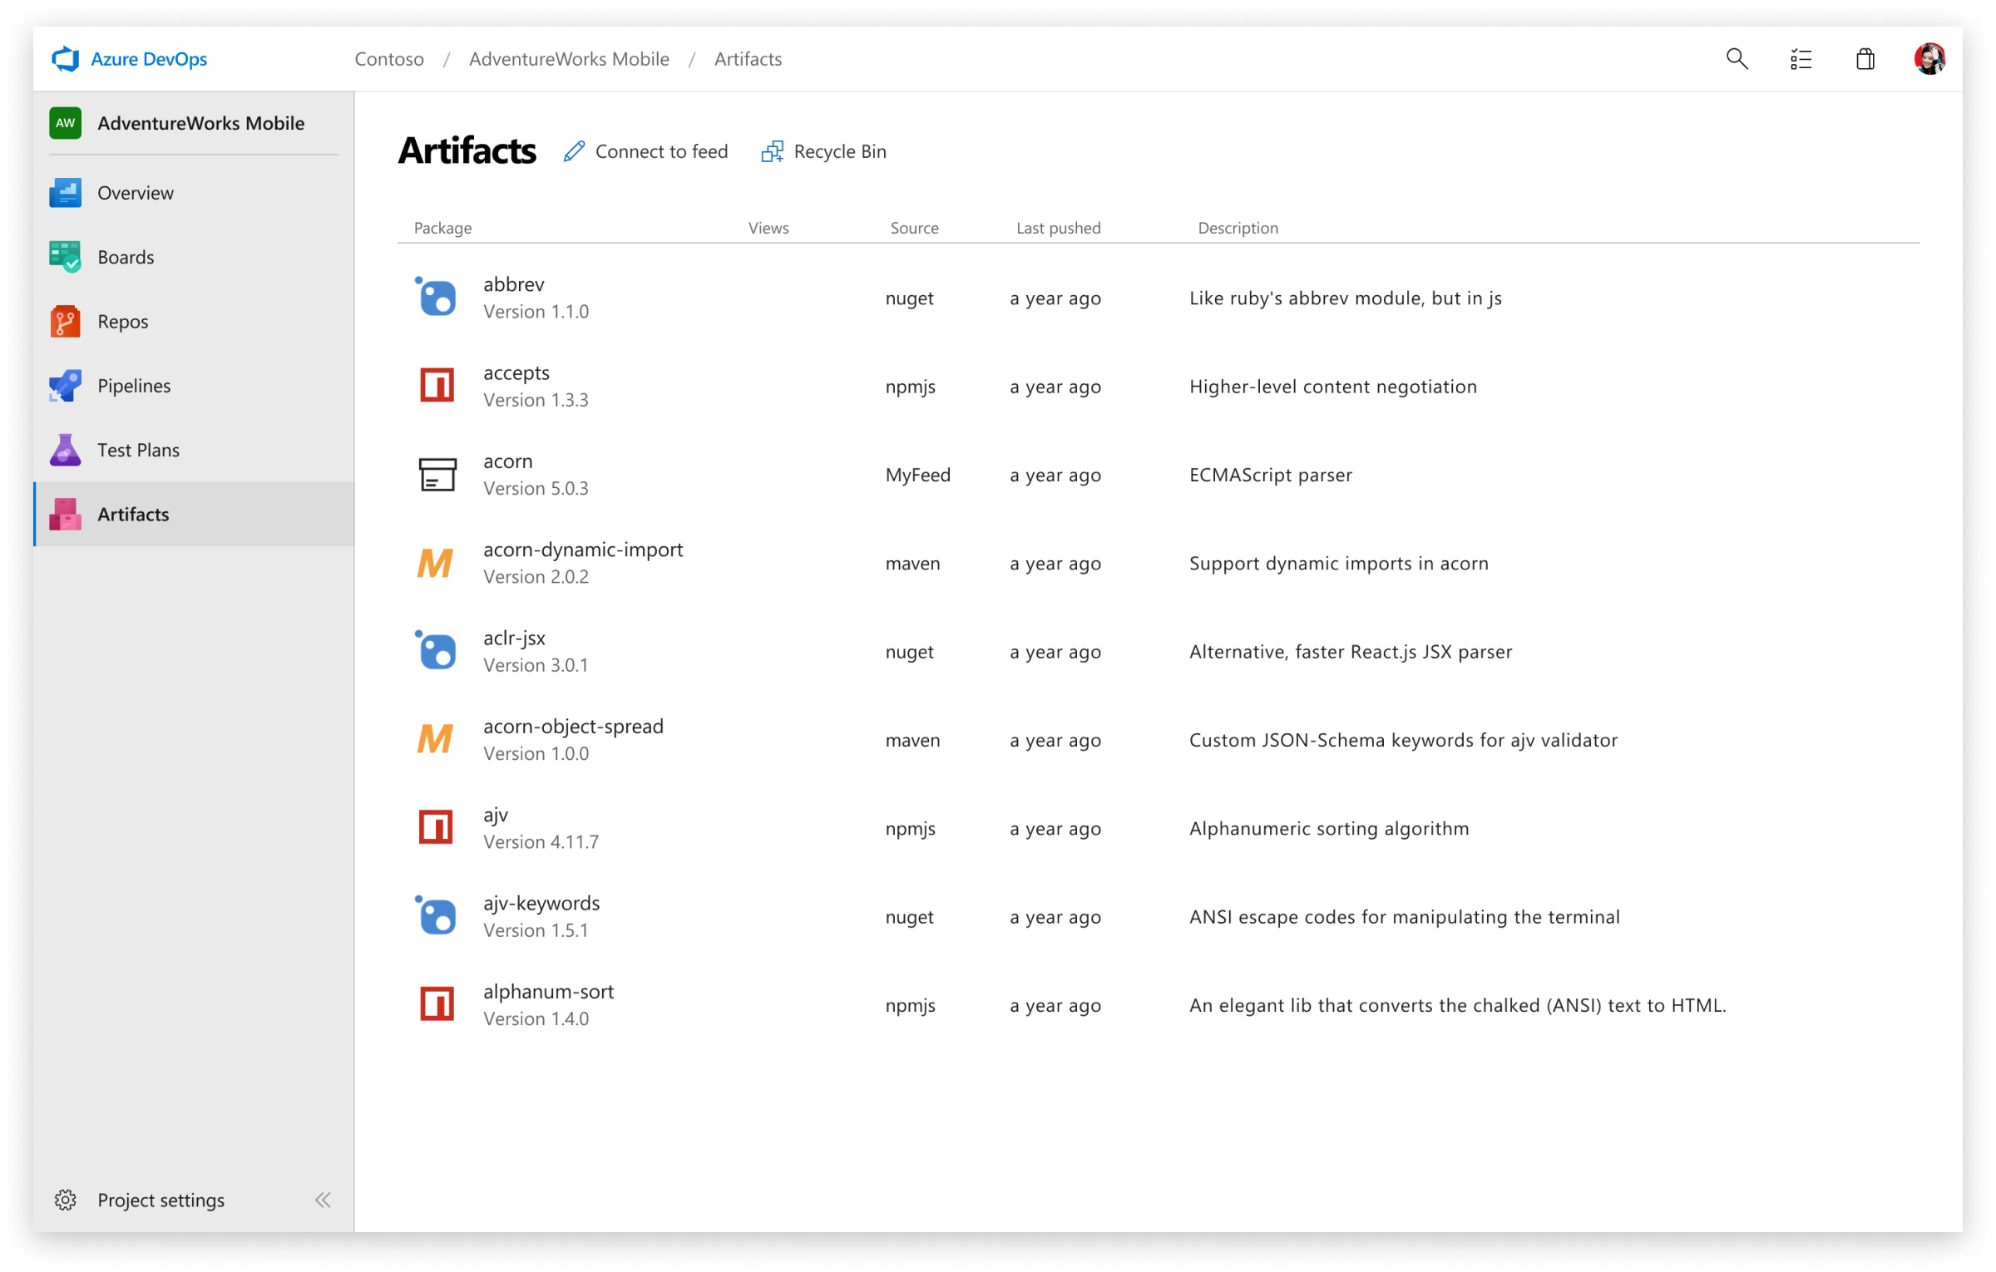
Azure DevOps services – Azure Artifacts
Notes:
With Azure Artifacts add fully integrated package management to your continuous integration/continuous delivery (CI/CD) pipelines with a single click. Create and share Maven, npm and NuGet packages from public and private sources with teams of any size.
With azure artifacts you can
Share code efficiently:
Easily share code across small teams and large enterprises.
Manage all package types:
Get universal artifact management for Maven, npm and NuGet.
Add packages to any pipeline:
Share packages, and use built-in CI/CD, versioning and testing.

Slide 42
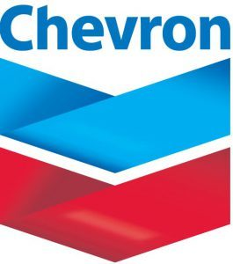


Real Life Examples
Chevron
American Cancer Society
SkyAlert
Notes:
With 40 scrum teams moving applications to the cloud at high speed, global energy provider Chevron needed a way to integrate its multifaceted and cross-functional efforts. The Scaled Agile Framework (SAFe) methodology held the key to Chevron’s success, but only after switching to Microsoft Azure Boards a tool from Azure DevOps could the company effectively use SAFe to build the scalable development framework it required. With Azure Boards, Chevron development teams now quickly deliver new business capabilities, keeping the company at the forefront of a fast-changing and increasingly demanding market.
The American Cancer Society counts on its volunteers, and its volunteers count on American Cancer Society mobile apps. To ease collaboration, accelerate development, organize processes, and reduce high database costs, the society’s IT team decided to adopt Microsoft Azure DevOps. The team drove its DevOps strategy by combining open-source technologies like .NET Core with Azure DevOps Services, Visual Studio Tools for Xamarin, Azure App Service, and Azure Cosmos DB. In the first year after adopting DevOps, the American Cancer Society increased funds raised by 86 percent and reduced data storage deployment costs by a phenomenal 1,000 percent.
Earthquakes strike without warning, killing hundreds and sometimes hundreds-of-thousands of people in a year. SkyAlert is one of four companies in the world that’s addressing this massive public safety threat by providing an early-warning system that alerts people in Mexico about an impending earthquake using a mobile app, standalone devices, and an Internet of Things (IoT) solution that runs in Microsoft Azure. In production just two months, three million people already use the mobile app, and more than 40 organizations, including Fortune 50 companies and schools, are using the standalone devices. The solution alerts people about an impending quake up to two minutes before it’s felt. By using Azure instead of onsite infrastructure, SkyAlert also saves money and it’s able to scale the solution to a new region in three months or less.

Slide 43
Continue with your own journey
Security Engineering – Secure DevOps
DevOps, Git, and Agile updates from the team building Azure DevOps
facebook.com/MSFTDev.US
@MSDEV

Slide 44
Thank You

Slide 45
Get the Latest…

Slide 46
Training & Documentation: microsoft.com/learn
Events & Resources: aka.ms/usdevskills
Developer newsletter: aka.ms/devsubscribe
facebook.com/MSFTDev.US
@MSDEV
Notes:
Microsoft has countless resources for developers. I would encourage you to save and bookmark these Urls.
Microsoft Learn – over 60 free self guided courses with documentation and labs created by Microsoft Engineering Teams where you can learn at your own pace.
The US Developer LinkedIn Point Drive, this is a custom curated list of the top developer events and skills resources
The Developer Newsletter, basically an insider view of the latest for developers served up in monthly newsletter

Slide 47


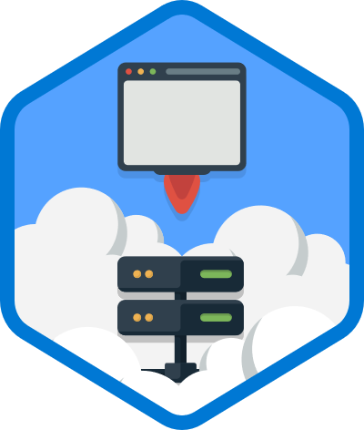
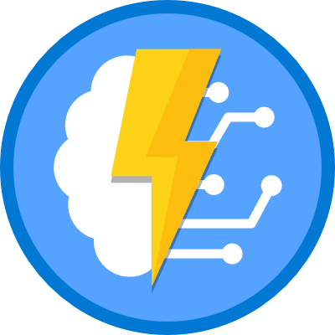
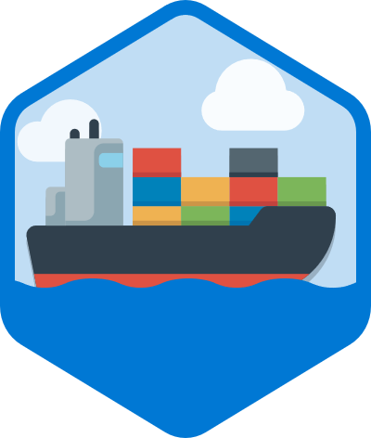
For Developers who are getting started in Azure
40 courses running March – June
2-3 hours in Length
Instructor Guided Hands-on Labs
Developer
Online Immersions
3 New Developer titles
1. Deploy a Web Site to Microsoft Azure with Azure App Service Join us for this live, facilitator-led immersive experience where you will learn how to build and publish Web apps in Microsoft Azure. During this interactive session, you will learn how to create a website through the hosted web app platform in Azure App Service. You will learn, hands-on, how to publish and manage your website easily, without having to work with the underlying servers, storage, or network assets. | 2. Create Serverless applications Join us for this live, facilitator-led immersive experience where you will learn how to build serverless architectures leveraging Azure functions to execute server-side logic. Experience hands-on how Azure functions enable the creation of event driven, compute-on-demand systems that can be triggered by various external events. You will also learn how to chain functions together through bindings to declare the data sources to read and write and let Azure Functions take care of the rest. | 3. Getting Started with Azure DevOps and Containers: Join us for this live, facilitator-led immersive experience where you will learn how Azure DevOps can help you release higher quality, well tested applications, on a shorter release cycle. Part one will focus on creating an Azure DevOps project, exploring the tool suite and learning how Azure DevOps works with your favorite open source tools you use today. Part II focuses on getting you hands on with Containers. Azure Container Instances are the quickest and easiest way to run containers in Azure. This immersion experience will teach you how to create and manage your containers, and how ACI can be used to provide elastic scale for Kubernetes
.
aka.ms/onlinecloudimmersions

Slide 48




25% Off Developer Courses
Contact us at sales@directionstraining.com or 855.575.8900 to take advantage. Use promo code: DevCamp25
Course title / training titles* | Course ID
Develop Azure Infrastructure as a Service compute Solutions | AZ-203T01-A
Develop Azure Platform as a Service compute solutions | AZ-203T02-A
Develop for Azure storage | AZ-203T03-A
Implement Azure security | AZ-203T04-A
Monitor, troubleshoot, and optimize Azure Solutions | AZ-203T05-A
Connect to and consume Azure, and third-party, services | AZ-203T06-A
Azure
Dev Camp
Deal
.
Azure DevOps Engineer
Course title / training titles | Course ID
Implement DevOps development processes | AZ-400T01
Implement continuous integration | AZ-400T02
Implement continuous delivery | AZ-400T03
Implement dependency management | AZ-400T04
Implement application infrastructure | AZ-400T05
Implement continuous feedback | AZ-400T06
Design a DevOps strategy | AZ-400T07
Azure Developer

Slide 49



40% Off Microsoft Exams
Contact us at sales@directionstraining.com or 855.575.8900 to take advantage. Use promo code: DevCamp40
40% discount on any MCP Certification exam voucher purchased from Directions.
Exam must be taken within 90 days of the purchase date.
Offer valid for all Microsoft Certification exams delivered by Pearson VUE except Microsoft Office Specialist (MOS) exams and Microsoft Technology Associate (MTA) exams.
Azure
Dev Camp
Deal
.

Slide 50
Time to Hands On Lab
facebook.com/MSFTDev.US
@MSDEV

